Slide 1


MAJOR PART-2
IMAGE CAPTIONING BOT
Under the supervision of: Dr. Himani Bansal

Slide 2


TABLE OF
CONTENTS
01
OUR TEAM
02
INTRODUCTION
03
MOTIVATION
04
APPROACH
05
COMPARISON WITH OTHER MODELS
06
WEBSITE
07
CONCLUSION

Slide 3



Chandrika Rajvanshi
(9920103096)
MEET
Abhay Arya
(9920103097
OUR TEAM
Samarth Gupta
(9920103100)

Slide 4
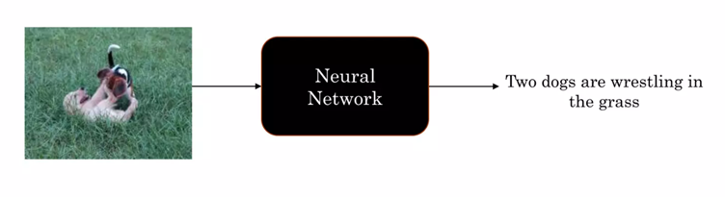

INTRODUCTION
Image captioning is the task of generating a descriptive and appropriate sentence of a given image.
Caption generation is a challenging Al problem where a textual description must be generated for a given image.
Two tasks involved:
Understand the content of the image.
Turn the understanding of the image into words in proper order.

Slide 5
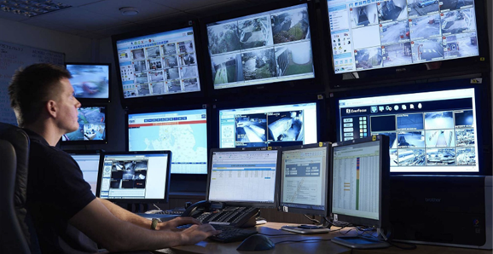
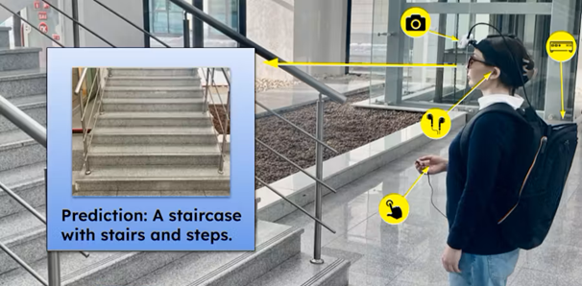

MOTIVATION
1.
Getting live captions from CCTV cameras.
2.
Aid to visually impaired people.

Slide 6
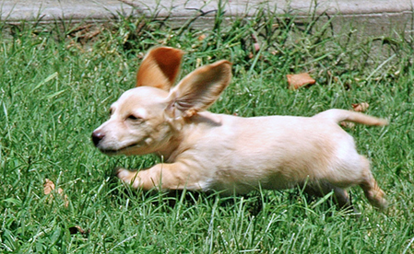

DATASET
Flickr8k Dataset:
8000 images
5 captions for each image
Larger datasets:
Flickr30k
MSCOCO
Caption 1: Little tan dog with large ears running through the grass.
Caption 2: Playful dog is running through the grass.
Caption 3: Small dogs ears stick up as it runs in the grass.
Caption 4: The small dog is running across the lawn.
Caption 5: This is small beige dog running through grassy field.

Slide 7

IMAGE FEATURE
EXTRACTION
CNN models to extract features:
Preprocess image
Pre-trained models used
ResNet-50
Inception v3
VGG-16
Parameters: 25,636,712
Input: 224 x 224 image
Output: 2048 feature vector
21,768,352 parameters
Input: 299 x 299 image
Output: 2048 feature vector
34,260,544 parameters
Input: 224 x 224 image
Output: 4096 feature vector

Slide 8


1. Load all descriptions
Create a dictionary mapping descriptions to images.
2. Clean descriptions
Convert all the words to lowercase
Remove all the punctuation
Remove words one character long
Remove words with numbers
3. Create a vocabulary
8,763 unique words
4. Save descriptions to a file
PREPARE TEXT DATA

Slide 9
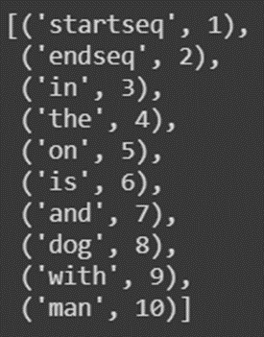

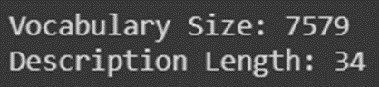
ENCODE
TEXT DATA
Convert descriptions to lists of words
Use a tokenizer
Map from words of the vocabulary to integers
Calculate vocabulary size
Compute maximum caption length

Slide 10
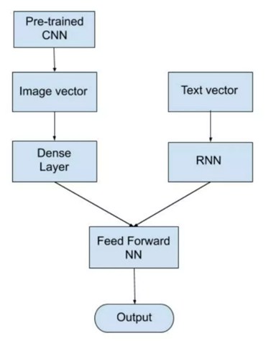
MODEL
ARCHITECTURE
We used an encoder-decoder architecture.
2048 image vector is fed to a Dense layer to generate a 256-length image vector.
34-length word vector is fed to LSTM/RNN to output a 256-length word vector.
The decoder model adds both the encoder outputs and is fed to the Dense 256 layer.
The last Dense layer will have as many nodes as the vocabulary size.
The last softmax layer predicts the next word present in the output vocabulary.

Slide 11
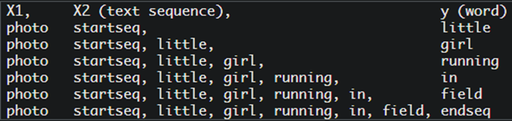
FIT
THE MODEL
30 epochs max (early stop)
32 batch size
Save only the lowest-loss model
Create sequences X1, X2, y
Data Generator
Avoid RAM and GPU limits
Shuffle train data
Work with image IDs

Slide 12
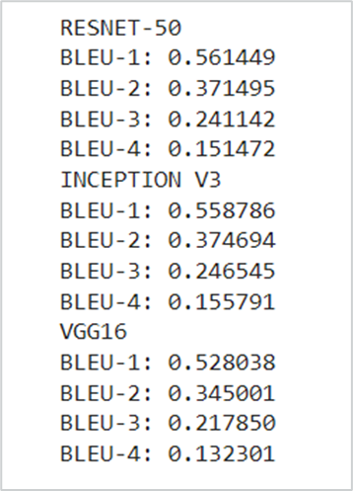
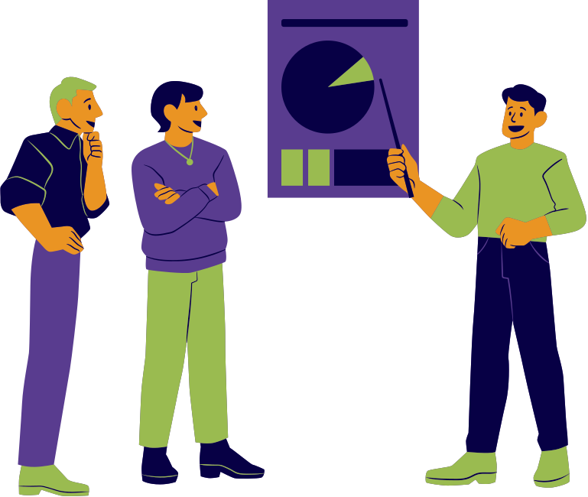
EVALUATION
METRICS
Bilingual Evaluation Understudy Score (BLEU)
BLEU is a metric for evaluating a generated sentence to a reference sentence.
BLEU score lies between 0 and 1.

Slide 13
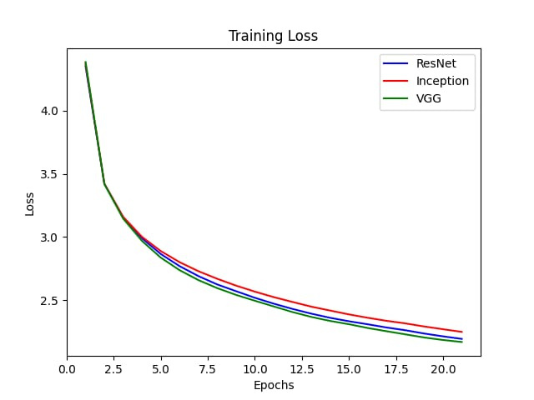

COMPARISON
OF MODELS

Slide 14
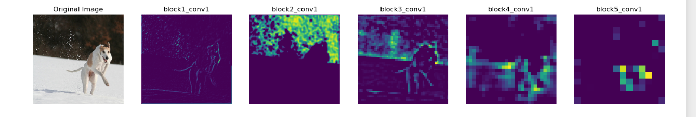
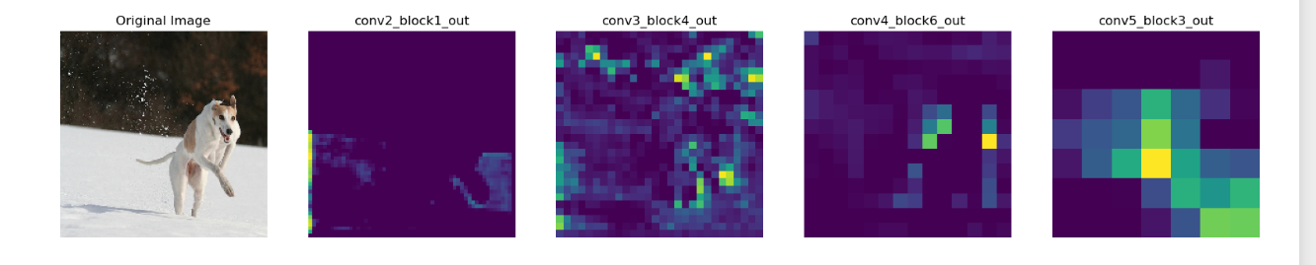
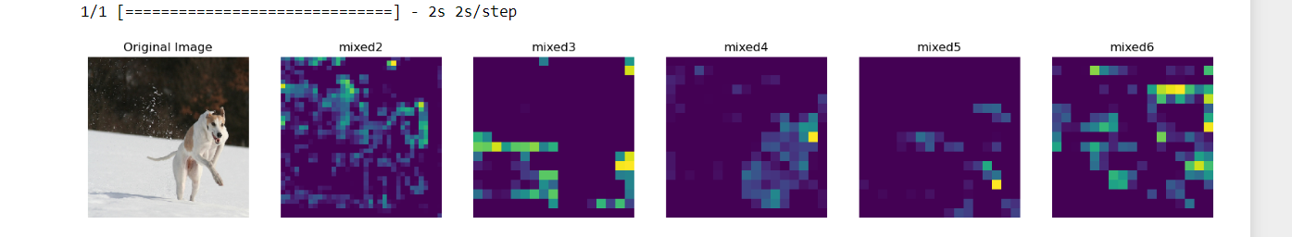
VGG-16
RESNET-50
INCEPTION V3

Slide 15
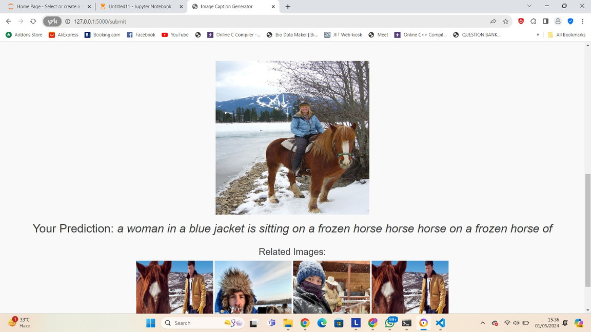
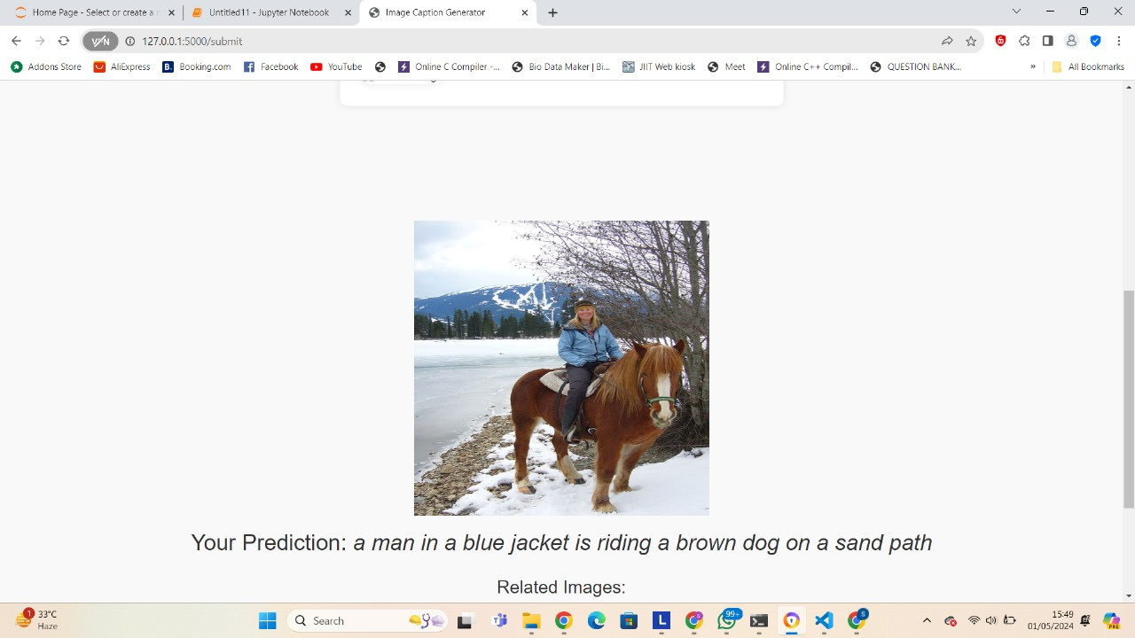
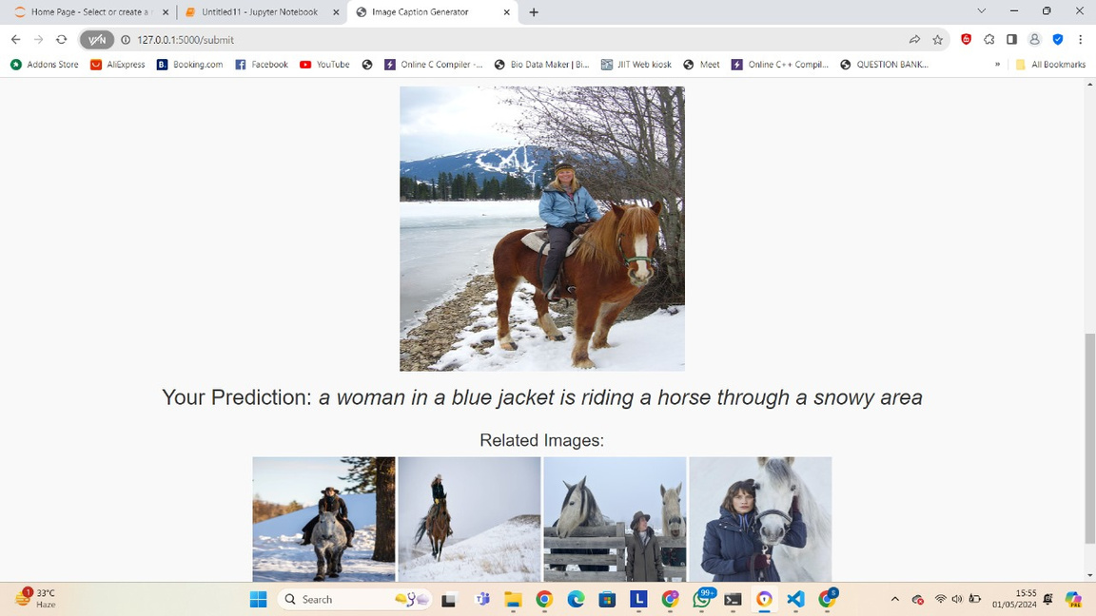
VGG-16
RESNET-50
INCEPTION V3

Slide 16

CREATION OF
WEBSITE

Slide 17
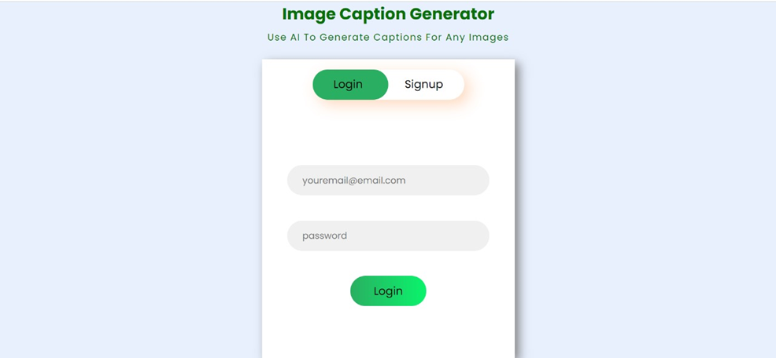
SIGN UP/LOGIN PAGE

Slide 18
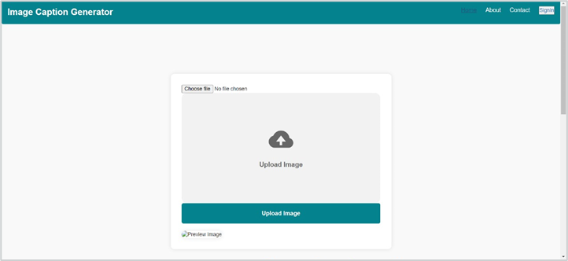
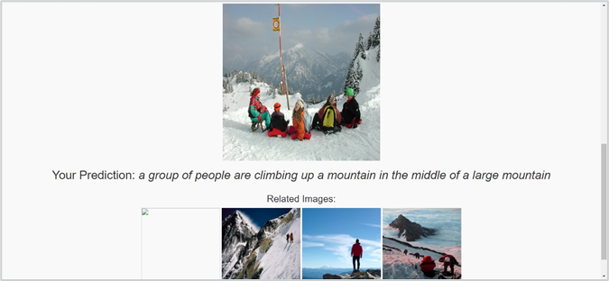

HOME PAGE
Related google images

Slide 19
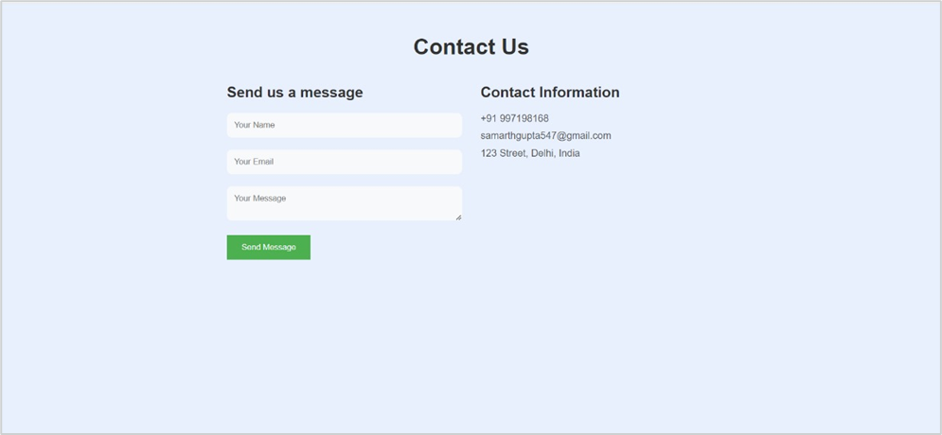
CONTACT US PAGE

Slide 20
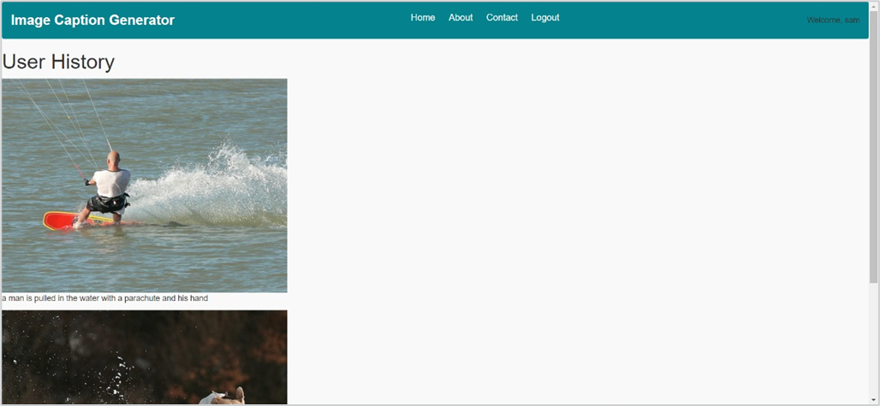
USER HISTORY PAGE

Slide 21
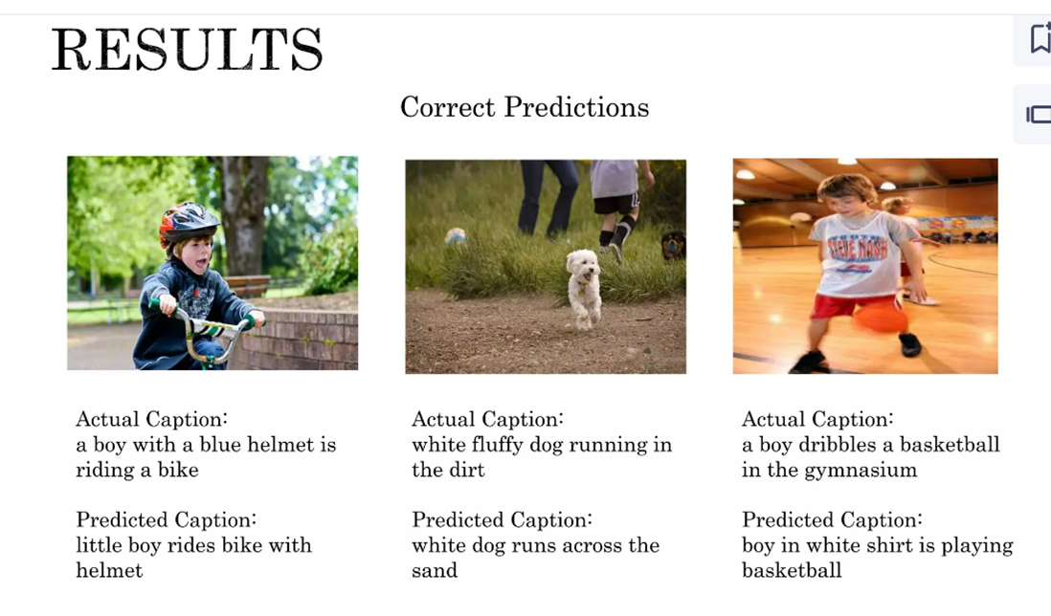
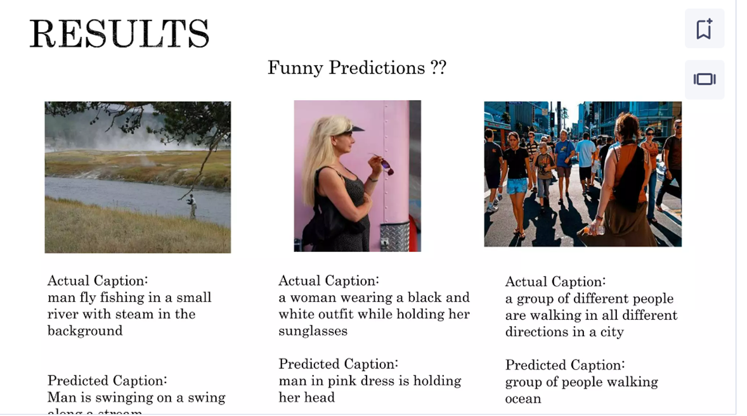
RESULTS

Slide 22

CONCLUSION
Caption generation is challenging.
We obtained quite good results.
Still, there are many mistakes.
Improvements:
Change model architecture
Remove some words from the vocabulary
Increase the size of the dataset (Flickr30k)
Implement attention correctly
Evaluate the model with beam search

